Slide 1
Chapter 13
Binary Input/Output
Objectives
❏ To understand the differences between text and binary files
❏ To write programs that read, write, and/or append binary files
❏ To be able to detect and take appropriate action when file errors occur
❏ To be able to process files randomly
❏ To be able to create text files from binary files and vice versa
❏ To understand and be able to implement file merges
❏ To understand and be able to implement the classic sequential file update

Slide 2
13-1 Text versus Binary Streams
In this section, we compare and contrast text streams versus binary streams.
Topics discussed in this section:
Text and Binary Files
Differences between Text and Binary Files
State of a File
Opening Binary Files
Closing Binary Files

Slide 3
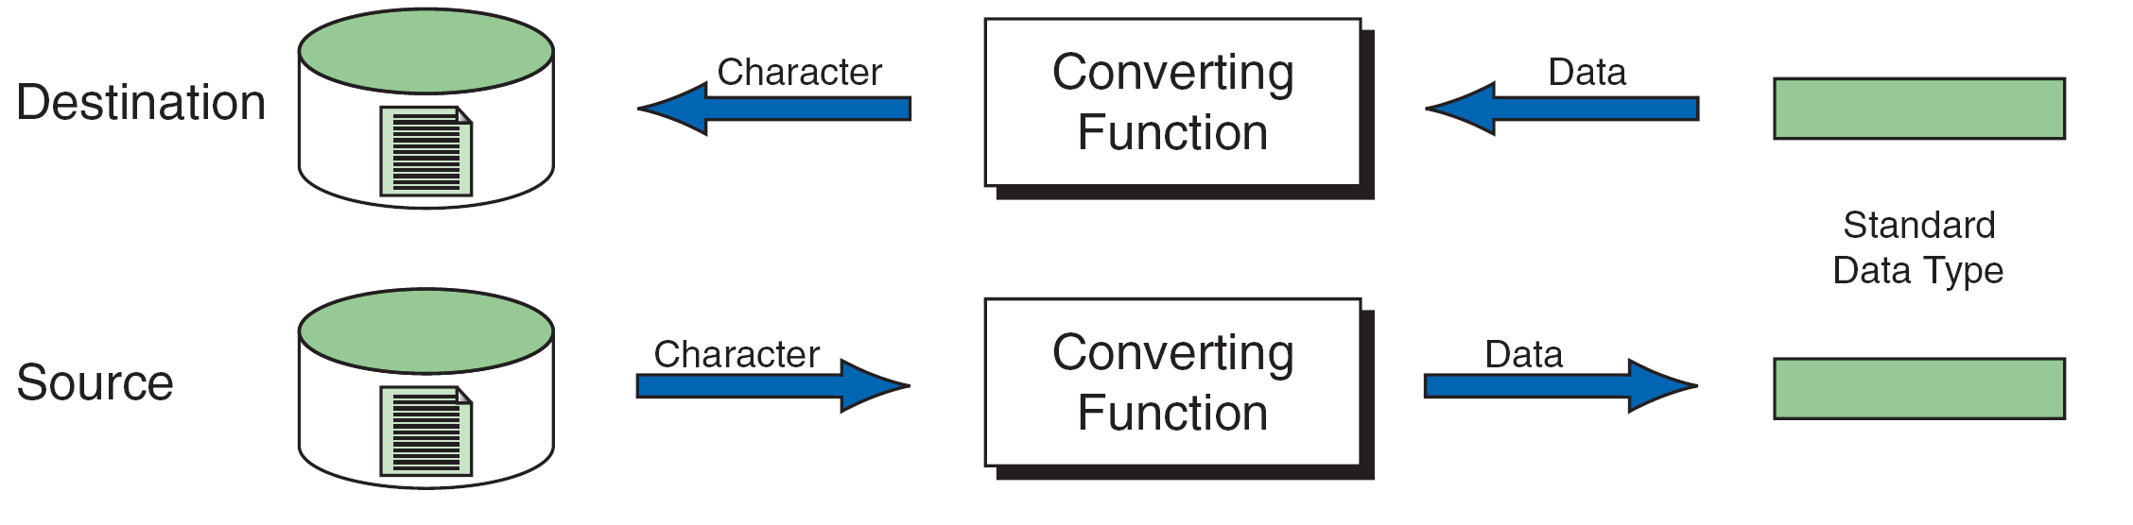
FIGURE 13-1 Reading and Writing Text Files

Slide 4
Note
Formatted input/output, character input/output, and string input/output functions can be used only with text files.

Slide 5
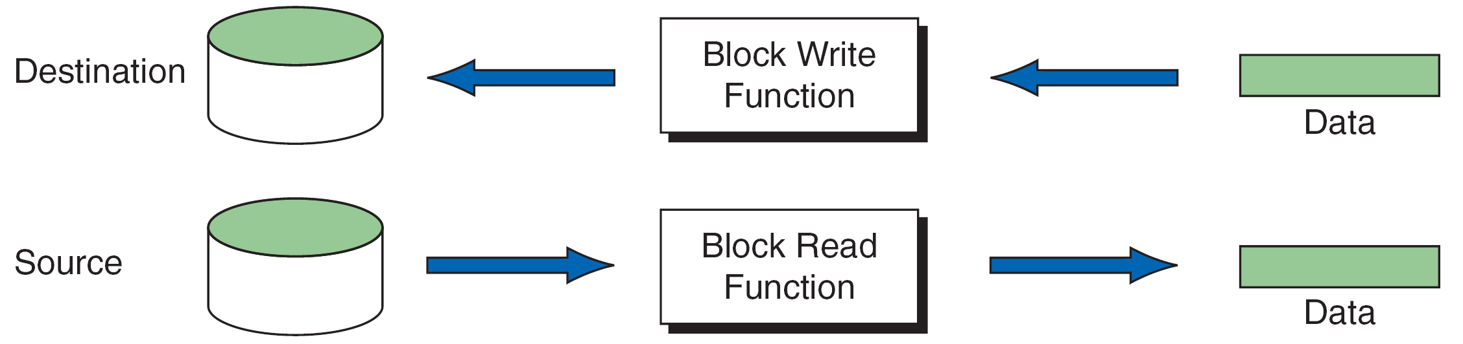
FIGURE 13-2 Block Input and Output

Slide 6
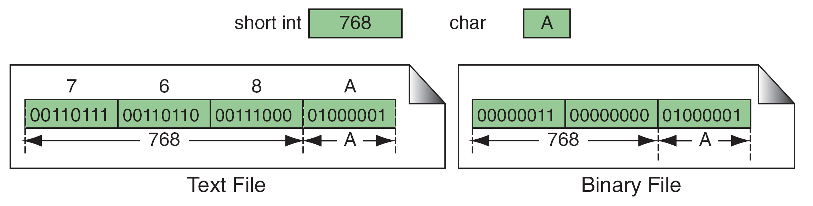
FIGURE 13-3 Binary and Text Files

Slide 7
Note
Text files store data as a sequence of characters; binary files store data as they are stored in primary memory.

Slide 8
Table 13-1
File Modes

Slide 9
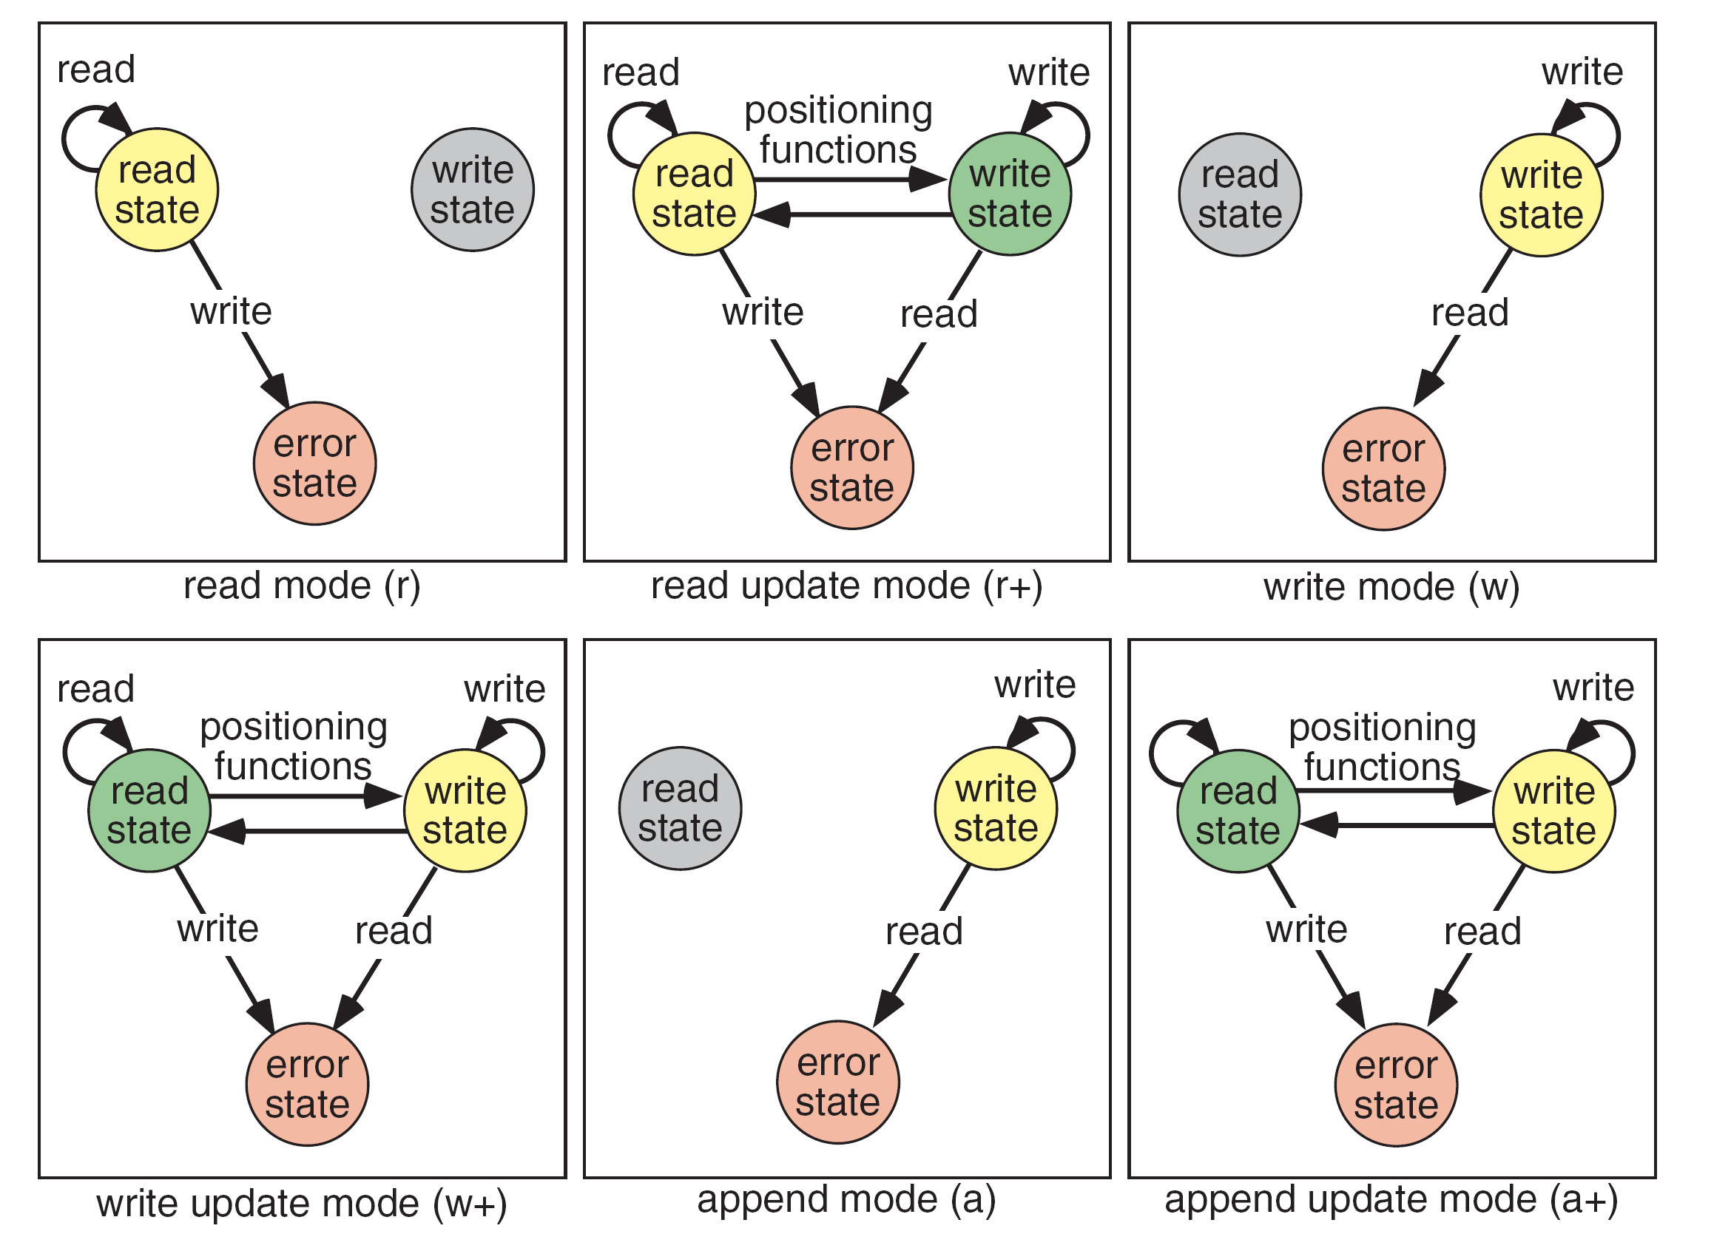
FIGURE 13-4 File States

Slide 10
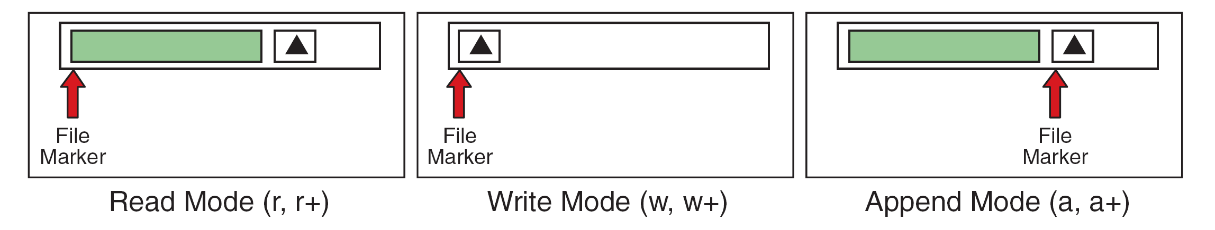
FIGURE 13-5 File-Opening Modes

Slide 11
13-2 Standard Library Functions
for Files
C has eight categories of standard file library functions. We have already discussed the first four in Chapter 7 and Chapter 11. We discuss the other four categories, which are more related to binary files, in this section.
Topics discussed in this section:
Block Input/Output Functions
File Status FunctionsComments
Positioning Functions
System File Operations

Slide 12
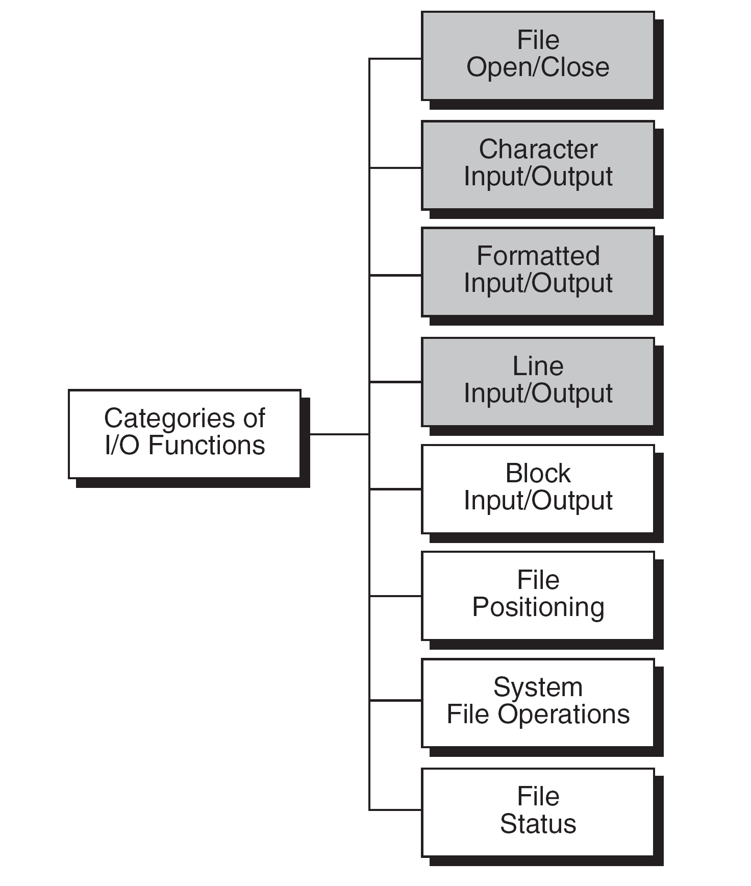
FIGURE 13-6 Types of Standard Input/Output Functions

Slide 13
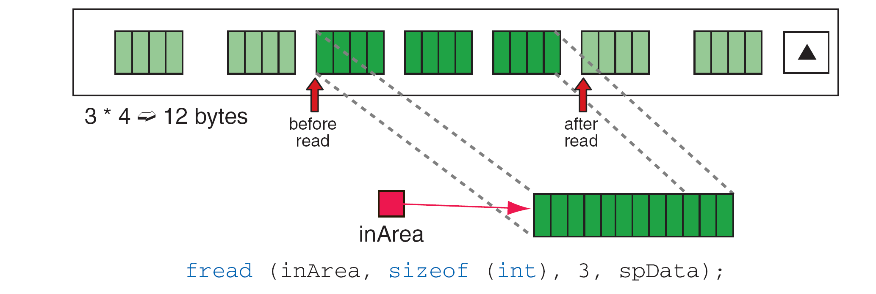
FIGURE 13-7 File Read Operation

Slide 14
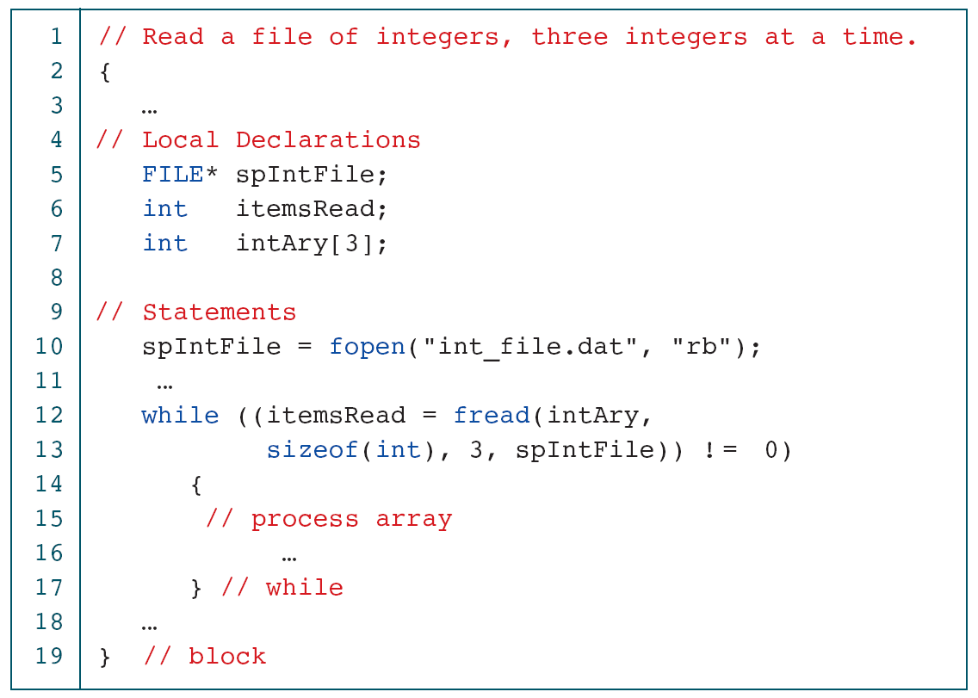
PROGRAM 13-1
Read File of Integers

Slide 15
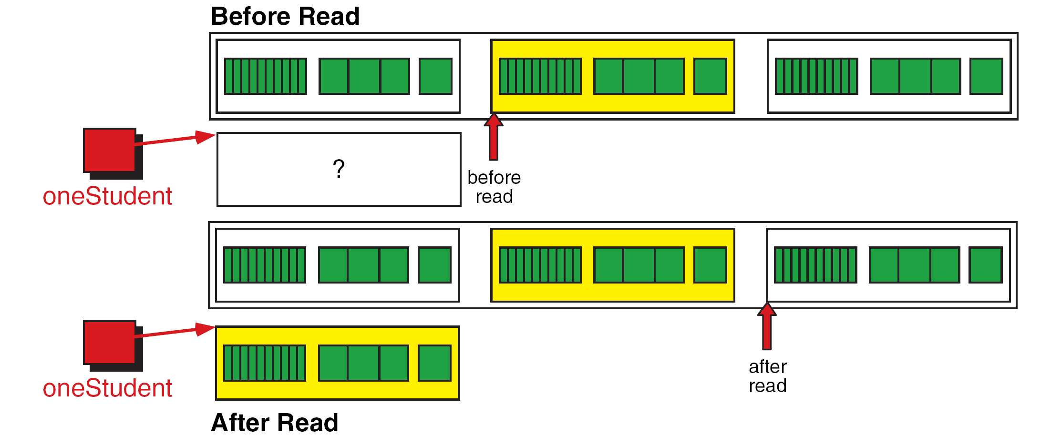
FIGURE 13-8 Reading a Structure

Slide 16
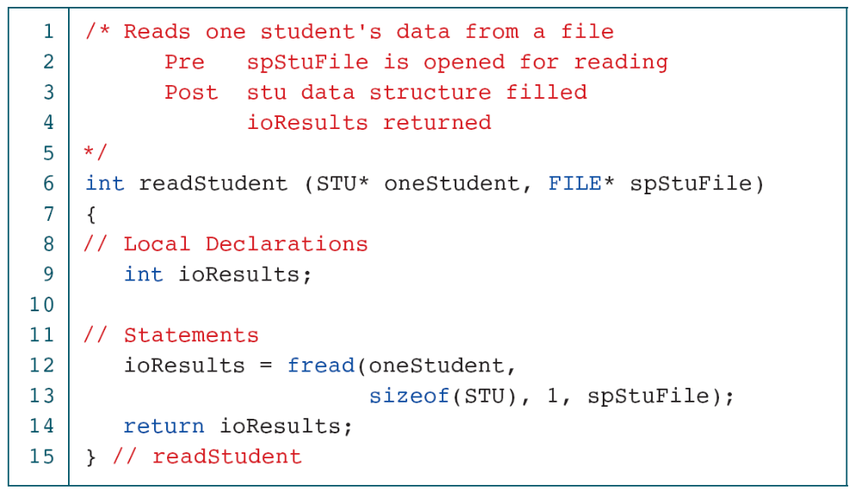
PROGRAM 13-2
Read Student File

Slide 17
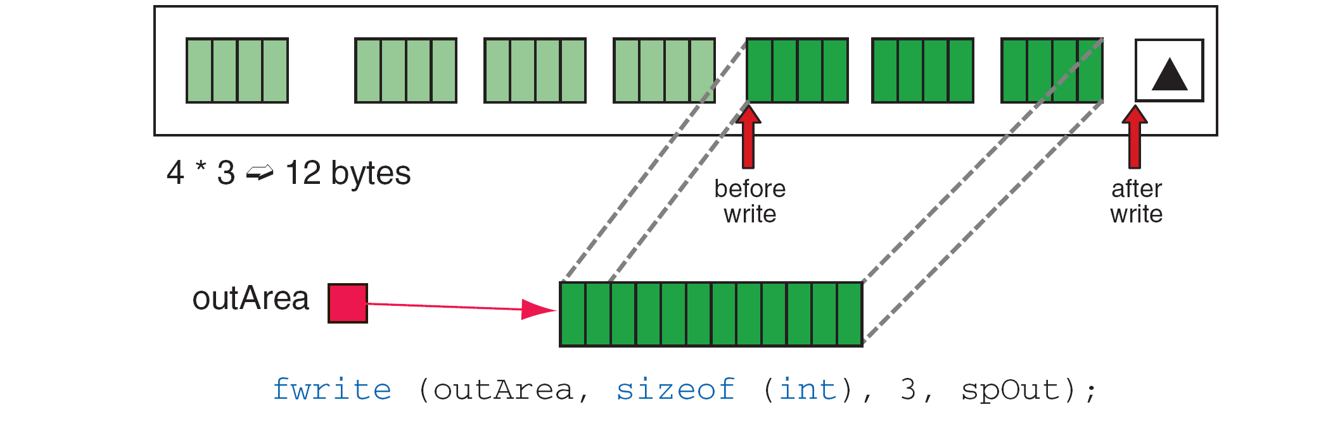
FIGURE 13-9 File Write Operation

Slide 18
FIGURE 13-10 Writing a Structure

Slide 19
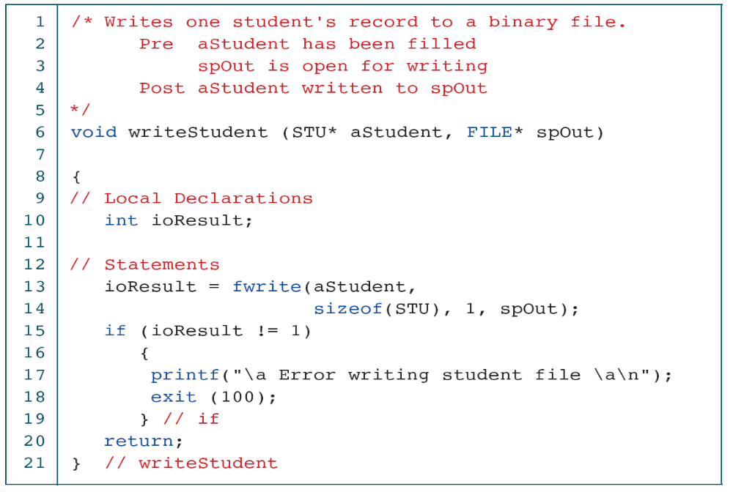
PROGRAM 13-3
Write Structured Data

Slide 20
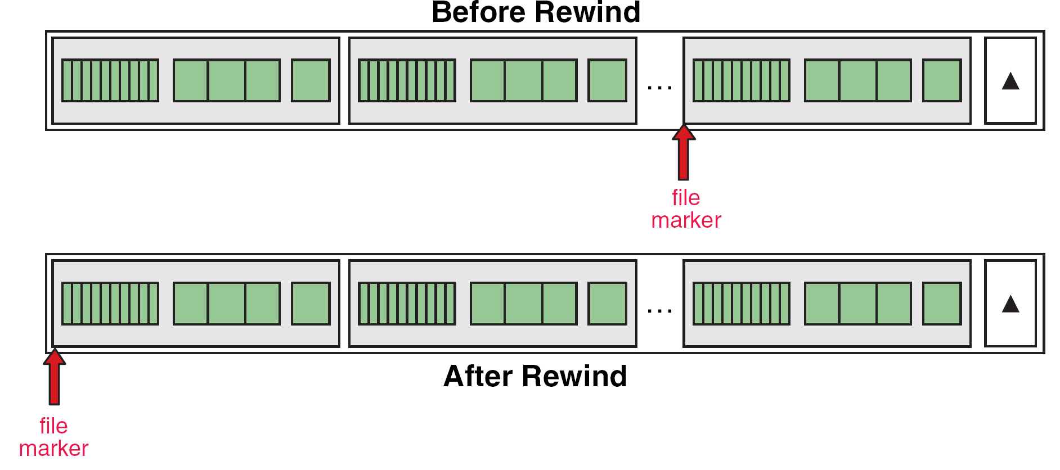
FIGURE 13-11 Rewind File

Slide 21
FIGURE 13-12 Current Location (ftell) Operation

Slide 22
FIGURE 13-13 File Seek Operation

Slide 23
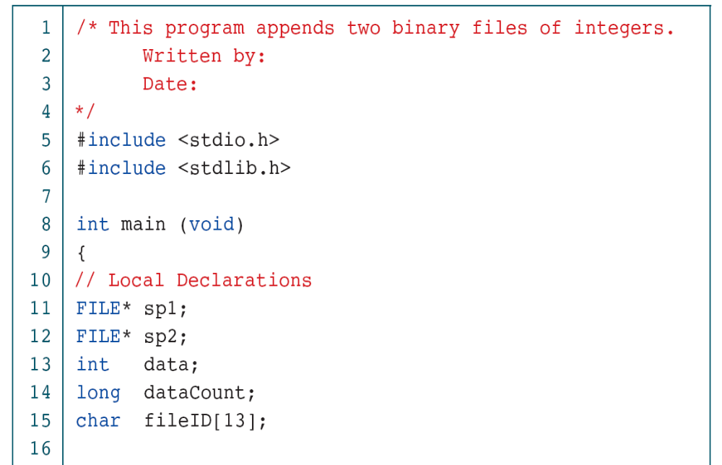
PROGRAM 13-4
Append Two Binary Files

Slide 24
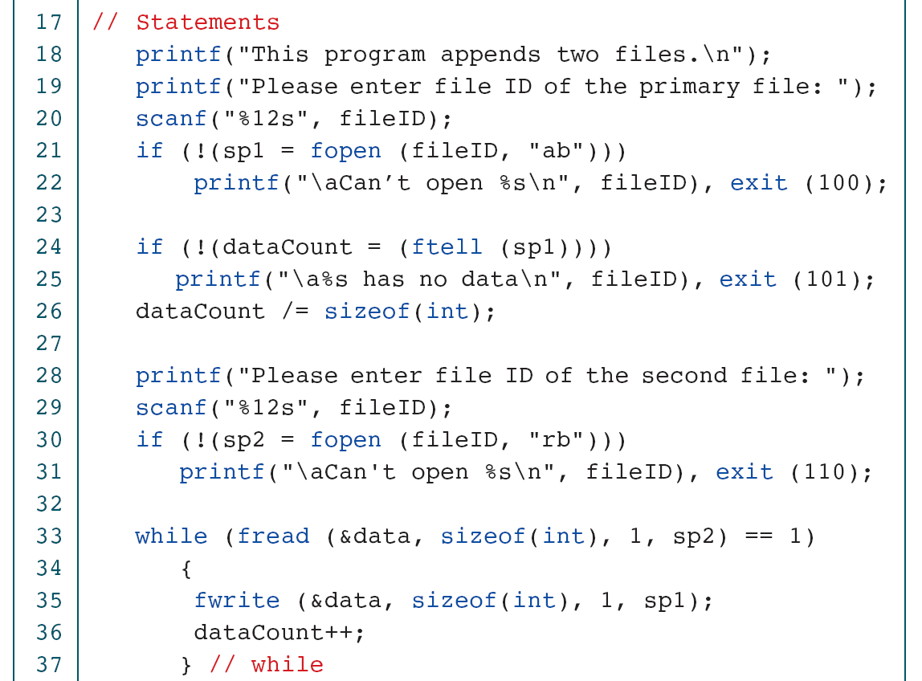
PROGRAM 13-4
Append Two Binary Files

Slide 25
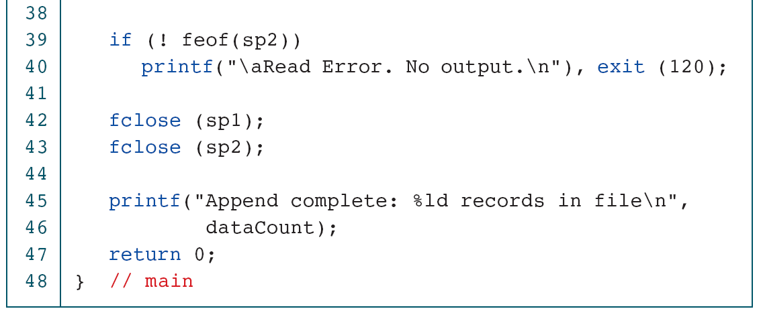
PROGRAM 13-4
Append Two Binary Files

Slide 26
13-3 Converting File Type
A rather common but somewhat trivial problem is to convert a text file to a binary file and vice versa. C has no standard functions for these tasks. We must write a program to make the conversion. We describe the file conversion logic in this section.
Topics discussed in this section:
Creating a Binary File from a Text File
Creating a Text File from a Binary File

Slide 27
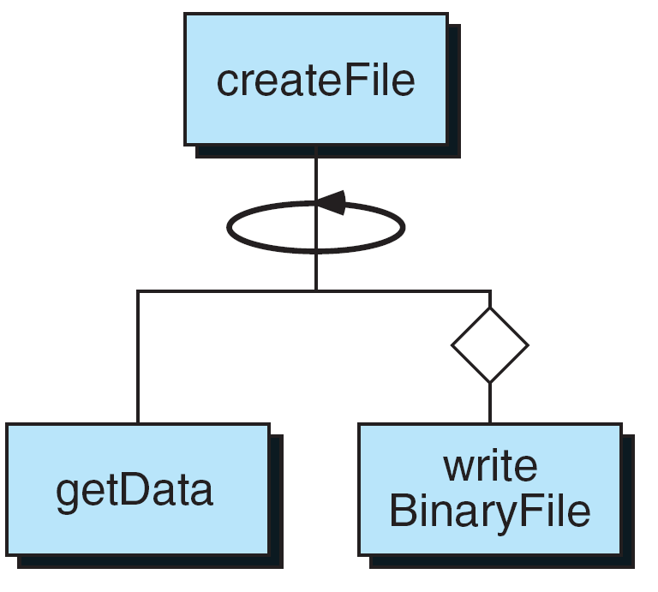
FIGURE 13-14 Create Binary File Structure Chart

Slide 28
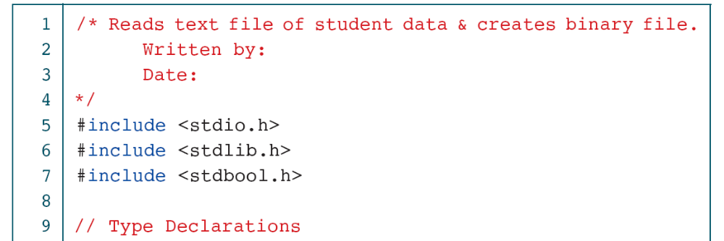
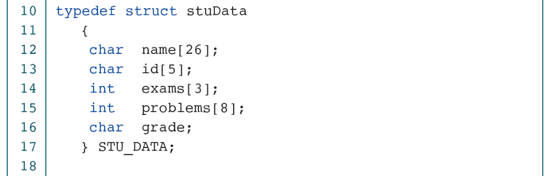
PROGRAM 13-5
Text to Binary Student File

Slide 29
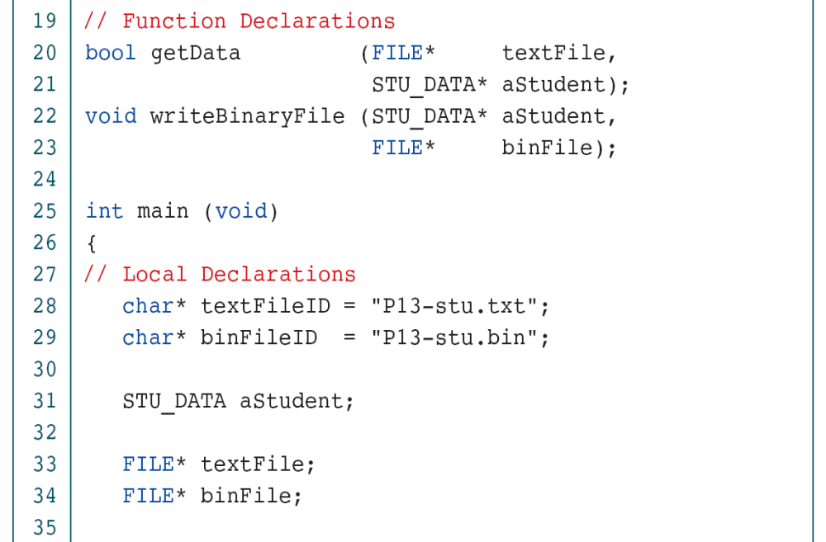
PROGRAM 13-5
Text to Binary Student File

Slide 30
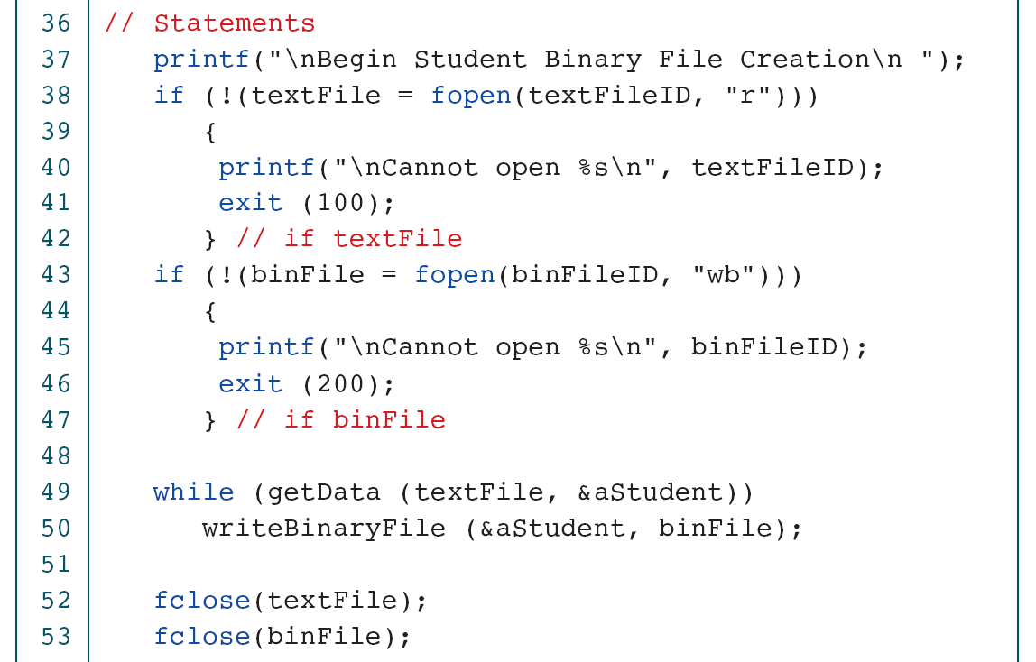
PROGRAM 13-5
Text to Binary Student File

Slide 31
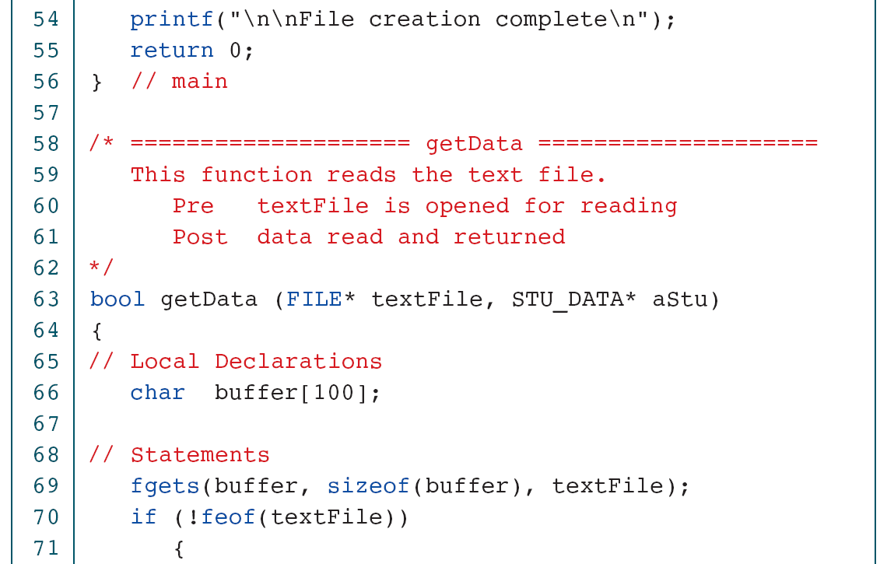
PROGRAM 13-5
Text to Binary Student File

Slide 32
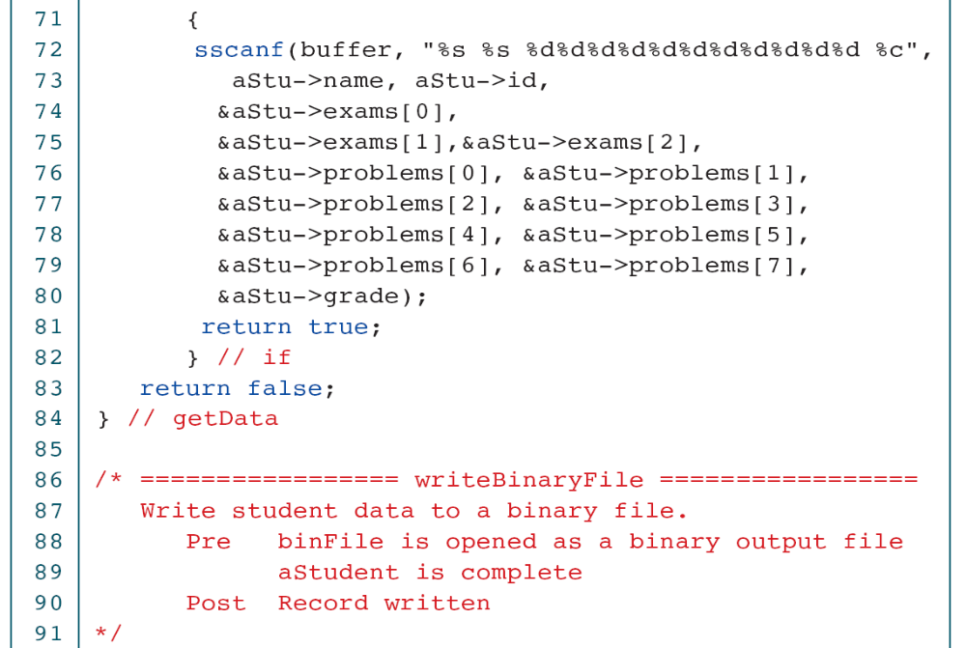
PROGRAM 13-5
Text to Binary Student File

Slide 33
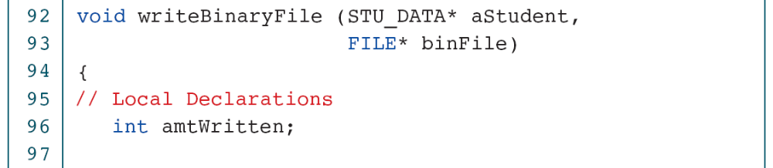
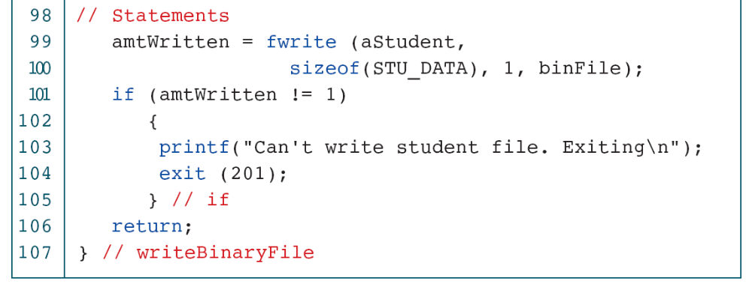
PROGRAM 13-5
Text to Binary Student File

Slide 34
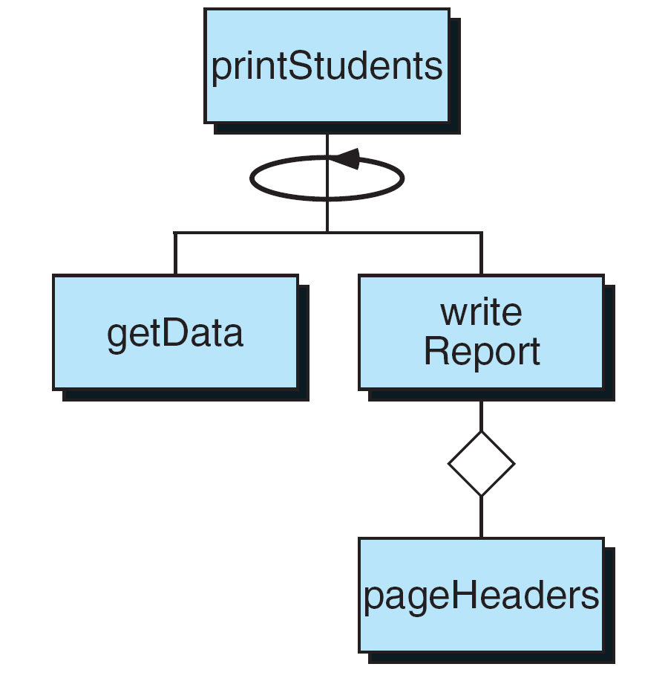
FIGURE 13-15 Design for Print Student Data

Slide 35
PROGRAM 13-6
Print Student Data

Slide 36
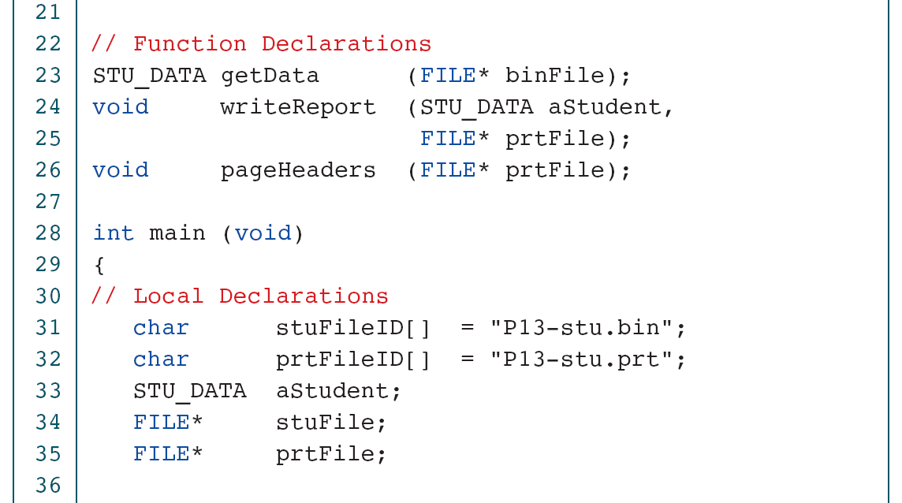
PROGRAM 13-6
Print Student Data

Slide 37
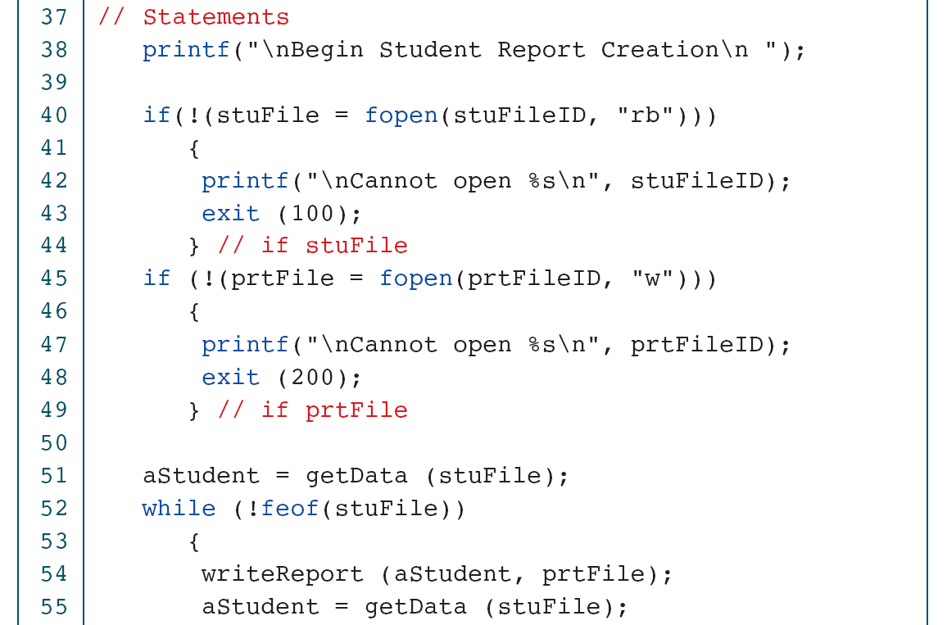
PROGRAM 13-6
Print Student Data

Slide 38
PROGRAM 13-6
Print Student Data

Slide 39
PROGRAM 13-6
Print Student Data

Slide 40
PROGRAM 13-6
Print Student Data

Slide 41
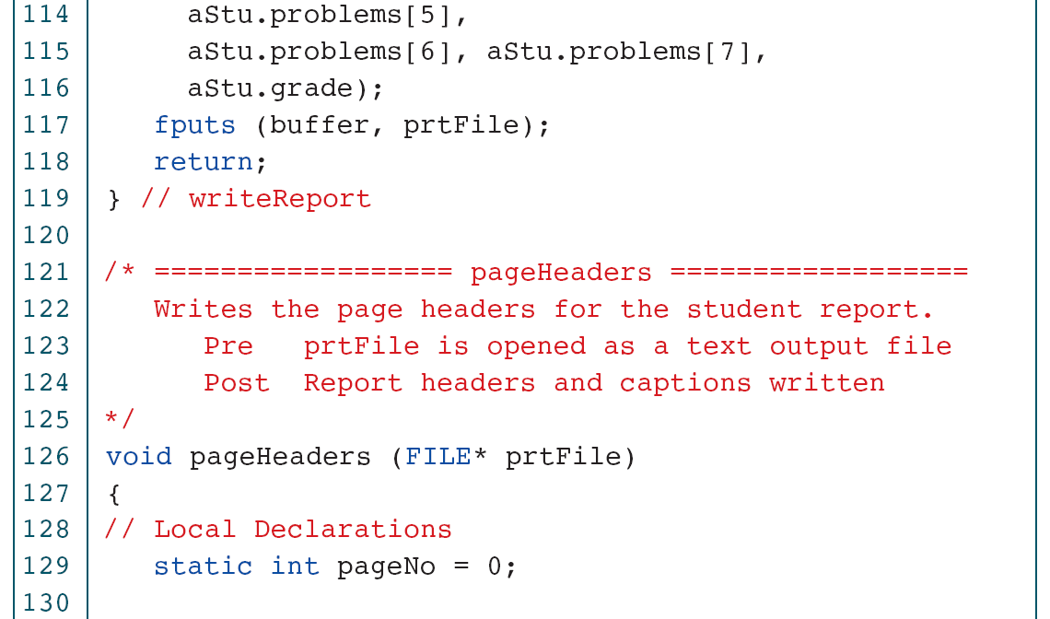
PROGRAM 13-6
Print Student Data

Slide 42
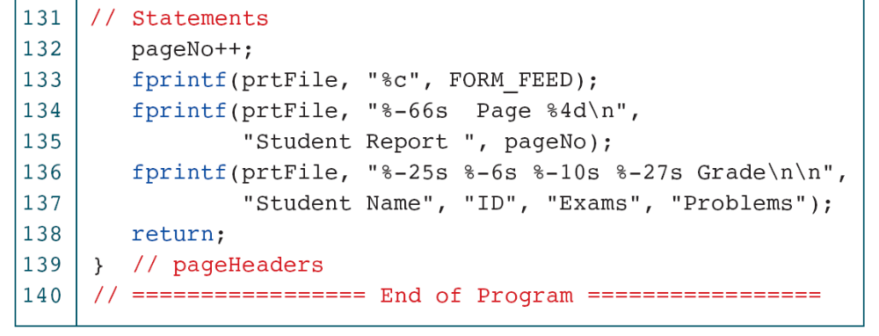
PROGRAM 13-6
Print Student Data

Slide 43
13-4 File Program Examples
This section contains two common file applications. The first uses the file positioning functions to randomly process the data in a file. The second merges two files.
Topics discussed in this section:
Random File Processing
Merge Files

Slide 44
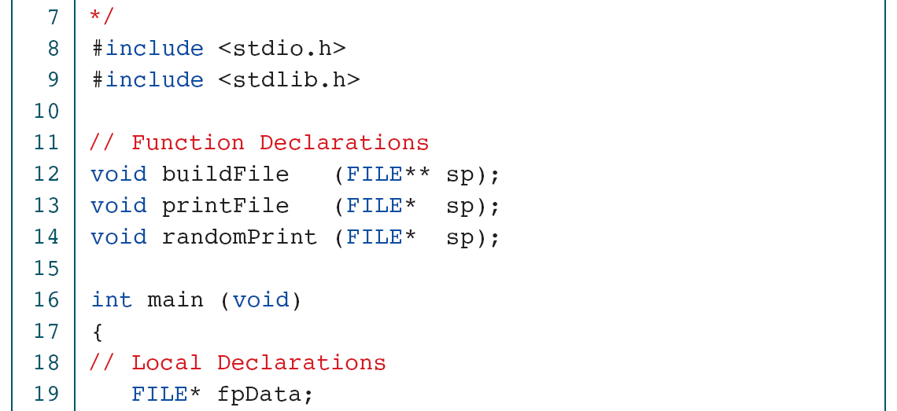
PROGRAM 13-7
Random File Application

Slide 45
PROGRAM 13-7
Random File Application

Slide 46
PROGRAM 13-8
Random File: Build File

Slide 47
PROGRAM 13-8
Random File: Build File

Slide 48
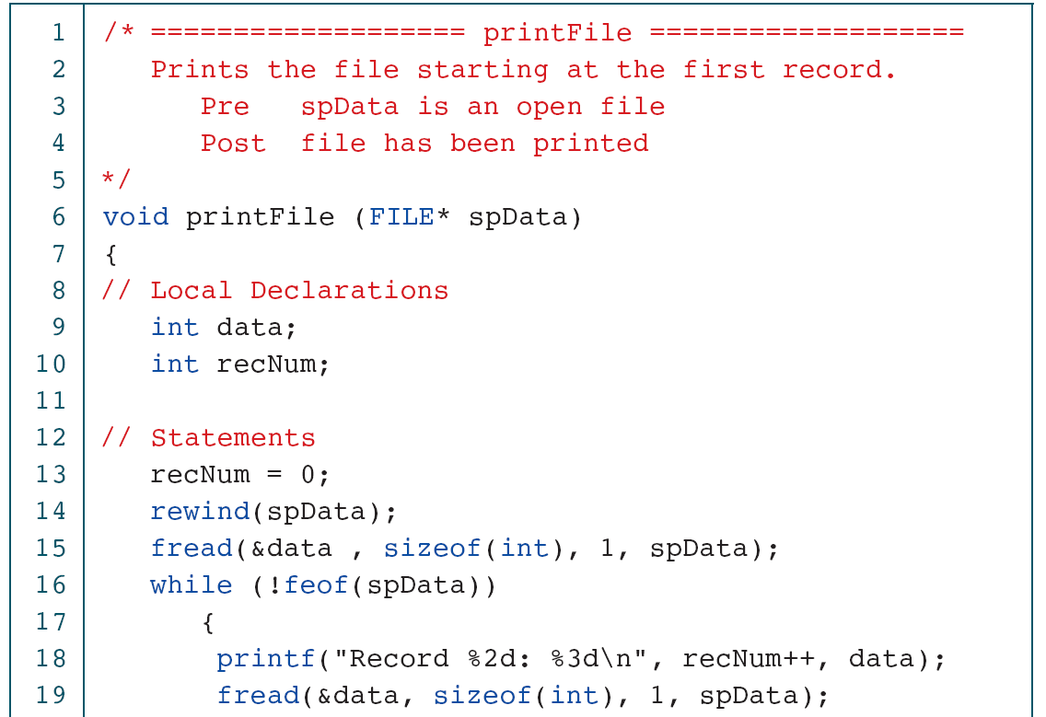
PROGRAM 13-9
Random File: Sequential Print

Slide 49
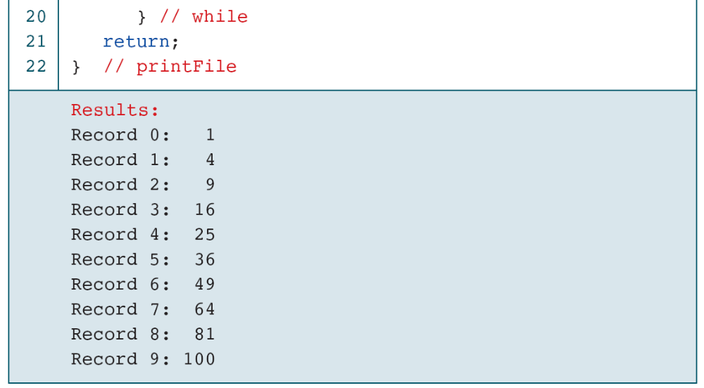
PROGRAM 13-9
Random File: Sequential Print

Slide 50
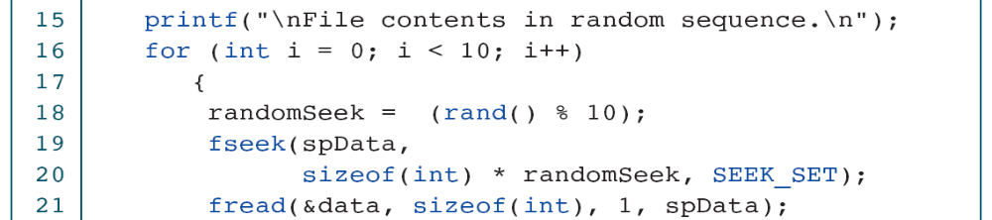
PROGRAM 13-10
Random File: Random Print

Slide 51
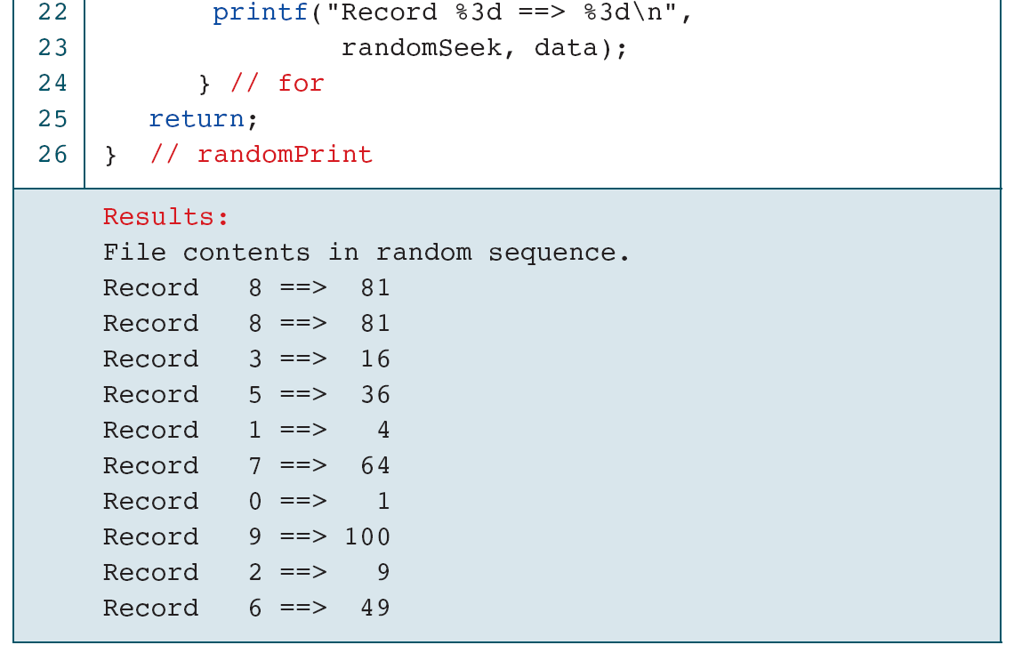
PROGRAM 13-10
Random File: Random Print

Slide 52
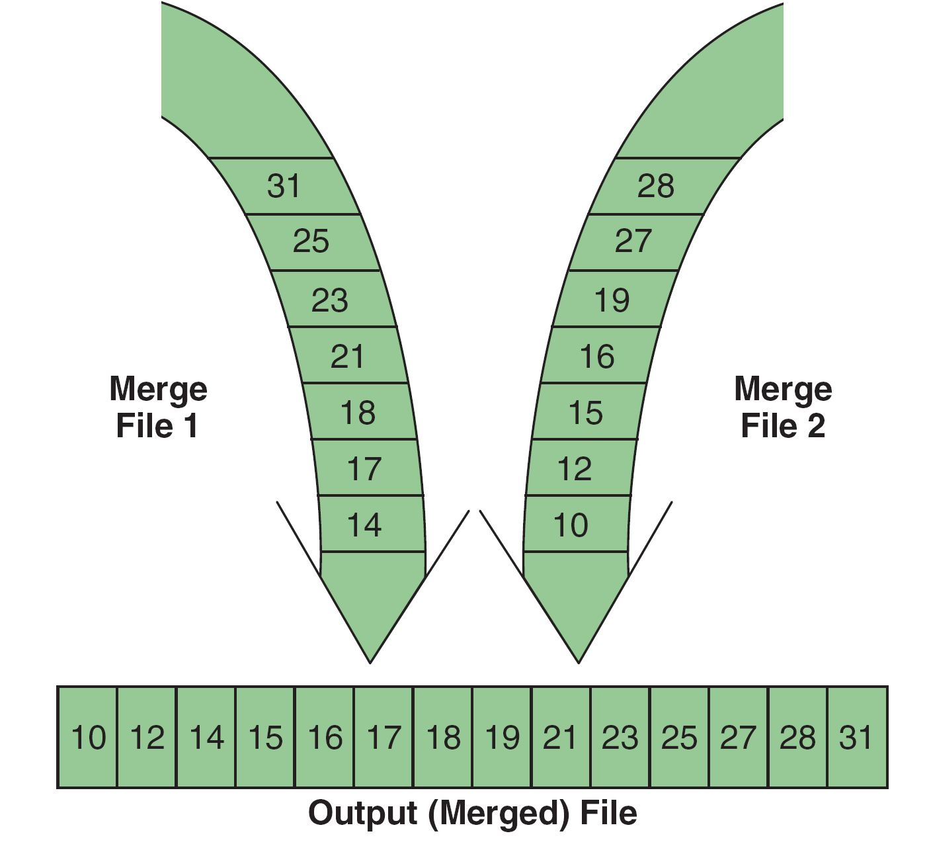
FIGURE 13-16 File Merge Concept

Slide 53
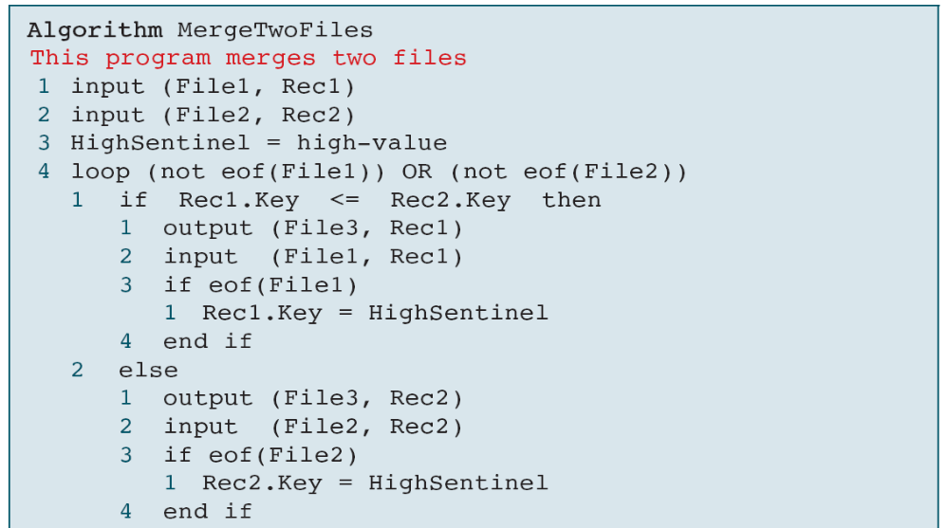
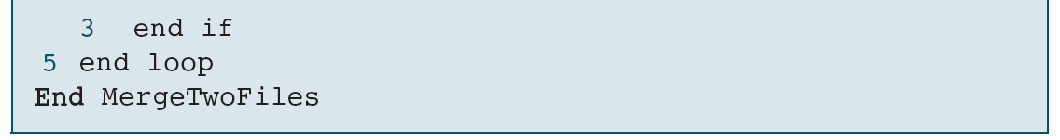
ALGORITHM 13-1
Pseudocode for Merging Two Files

Slide 54
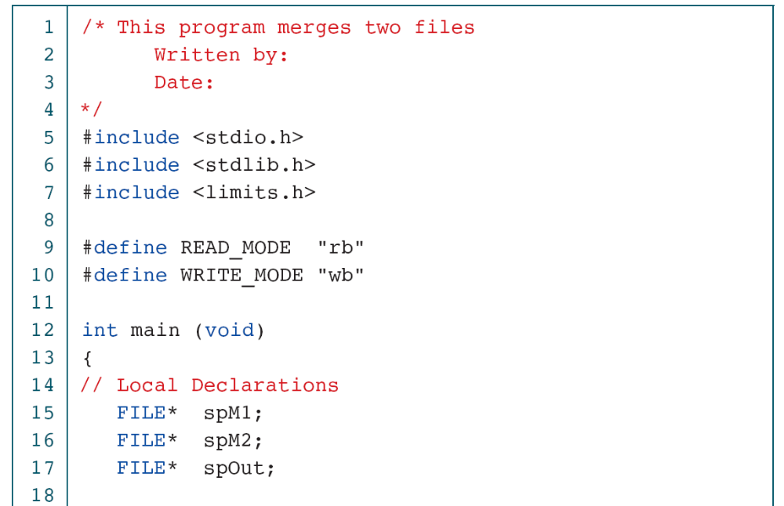
PROGRAM 13-11
Merge Two Files

Slide 55
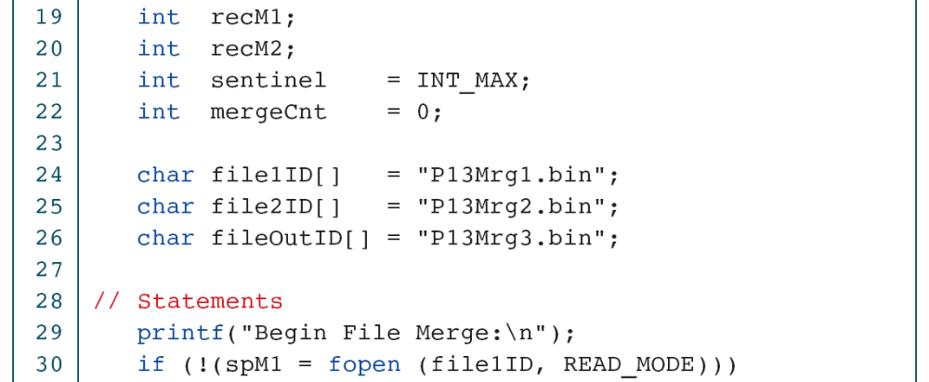
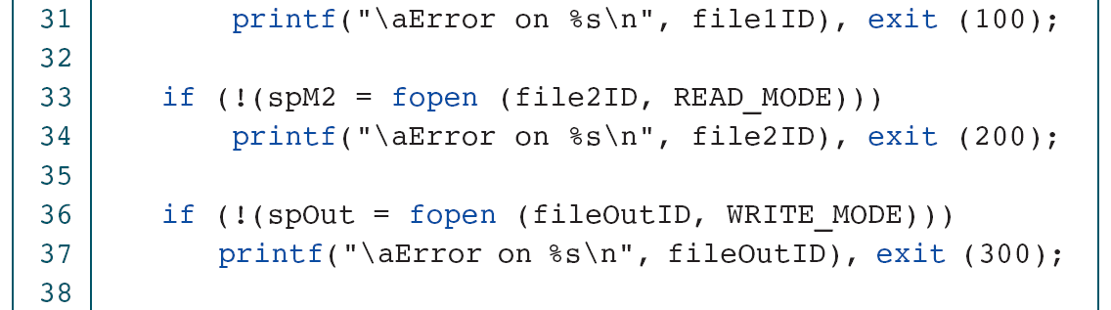
PROGRAM 13-11
Merge Two Files

Slide 56
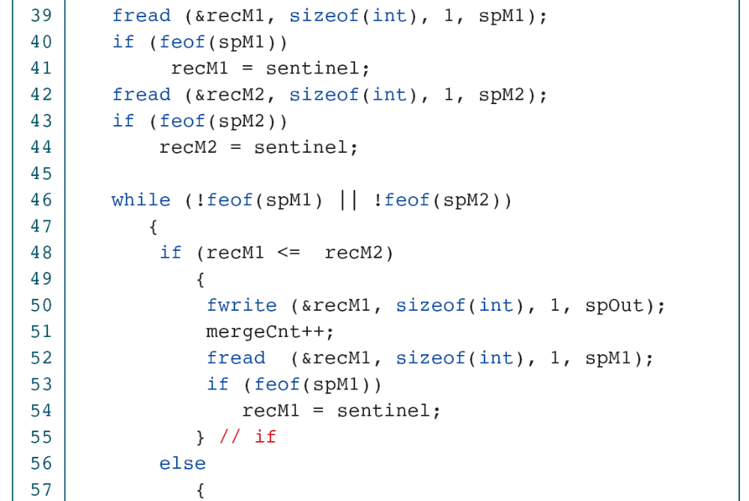
PROGRAM 13-11
Merge Two Files

Slide 57
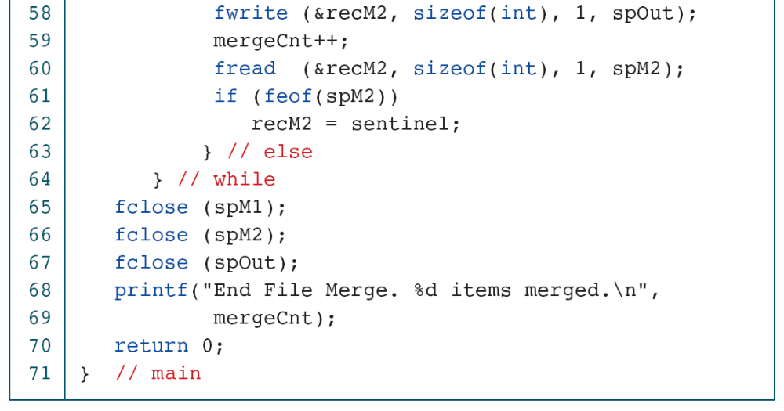
PROGRAM 13-11
Merge Two Files

Slide 58
13-5 Software Engineering
Any file environment requires some means of keeping the file current. The function that keeps files current is known as updating. To complete our discussion of files, we discuss some of the software engineering design considerations for file updating.
Topics discussed in this section:
Update Files
Sequential File Update
The Update Program Design
Update Errors
Update Structure Chart and Logic

Slide 59
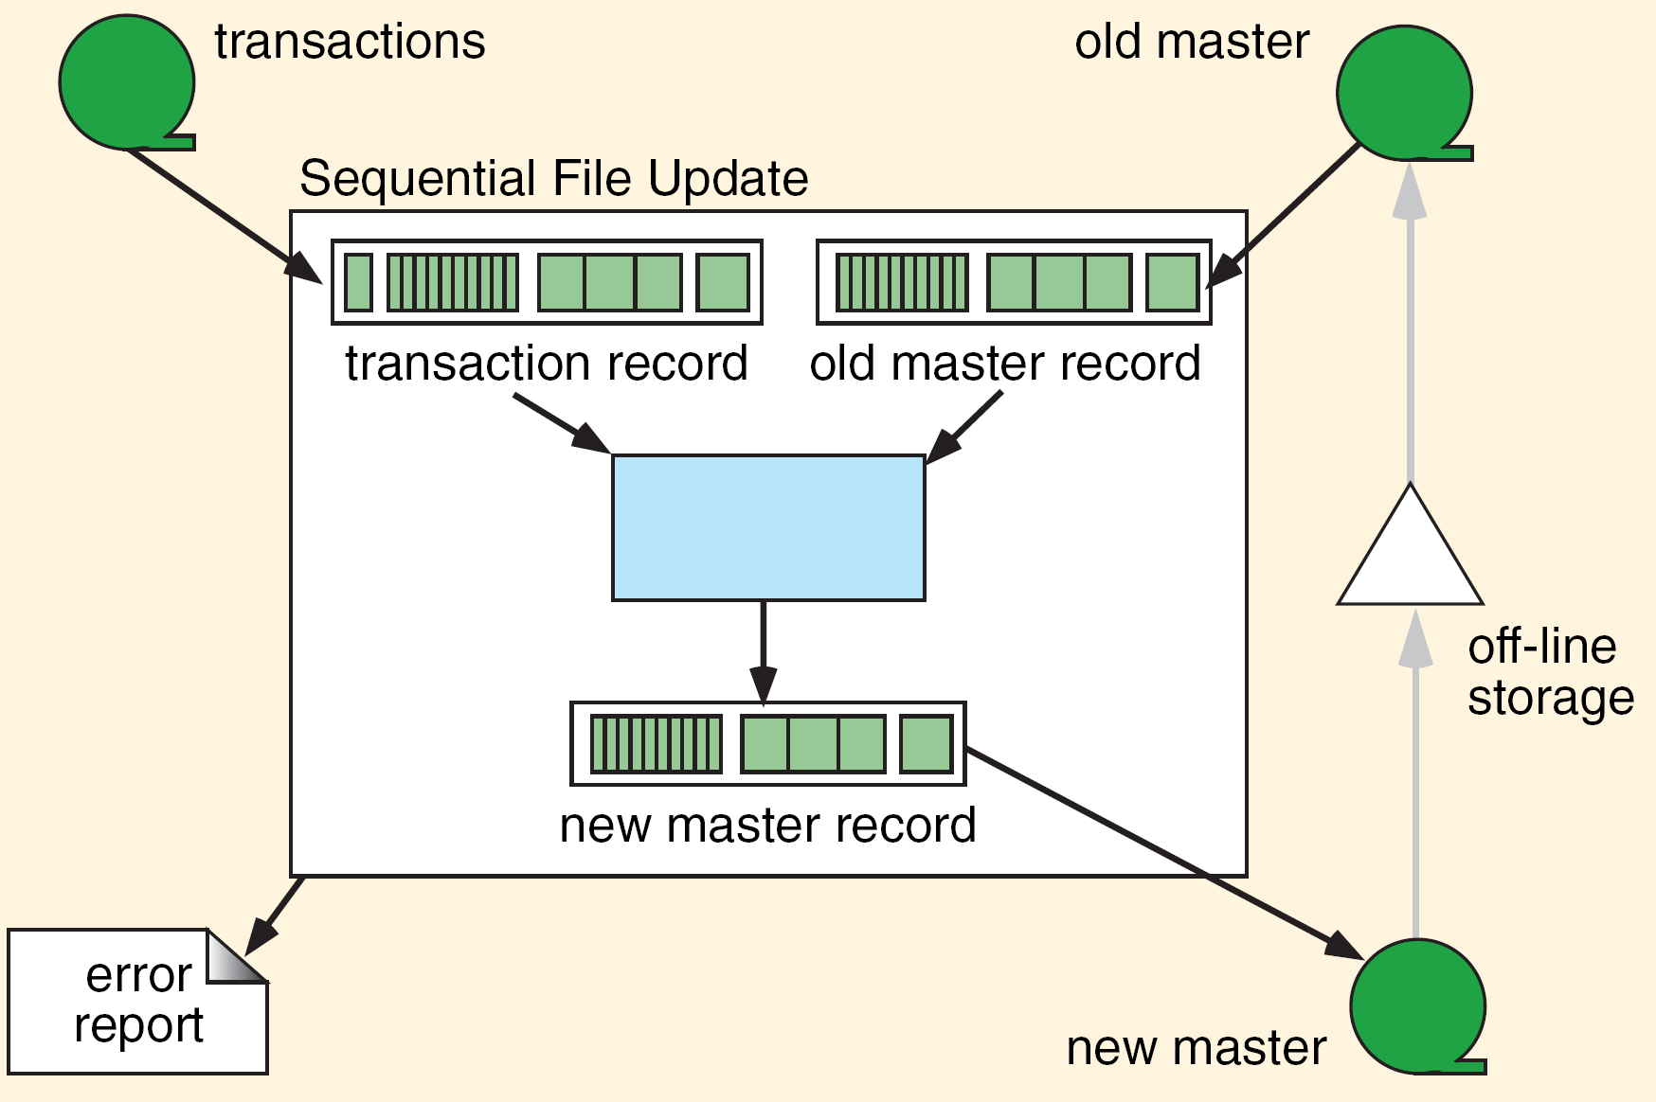
FIGURE 13-17 Sequential File Update Environment

Slide 60
FIGURE 13-18 File Updating Example

Slide 61
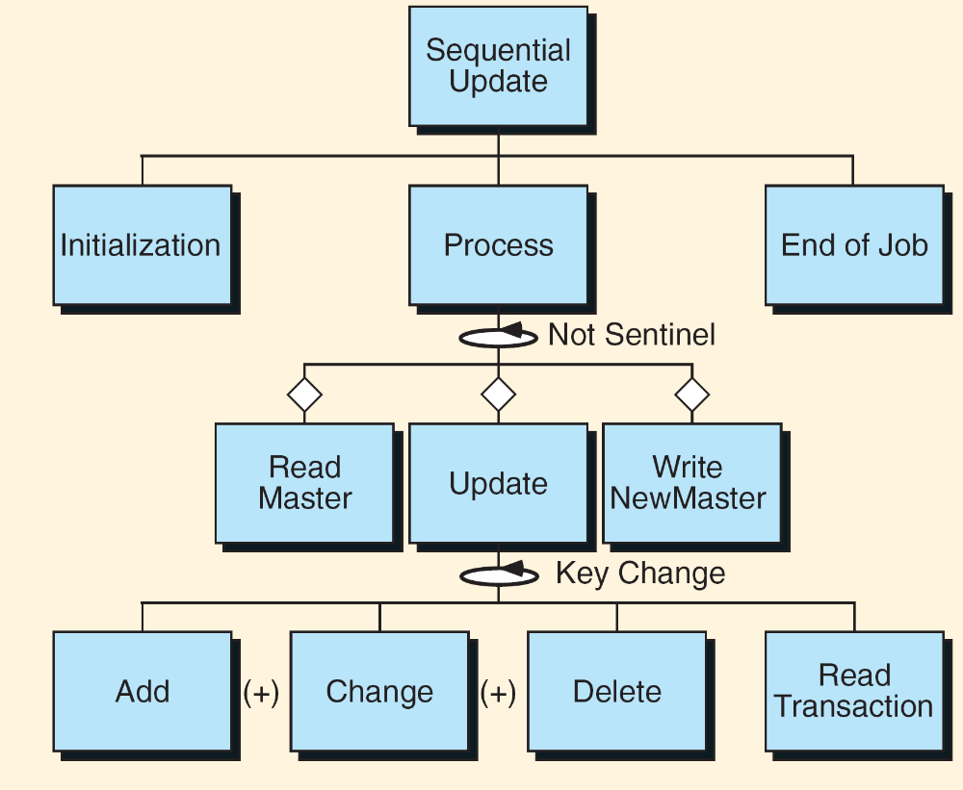
FIGURE 13-19 Update Structure Chart

Slide 62
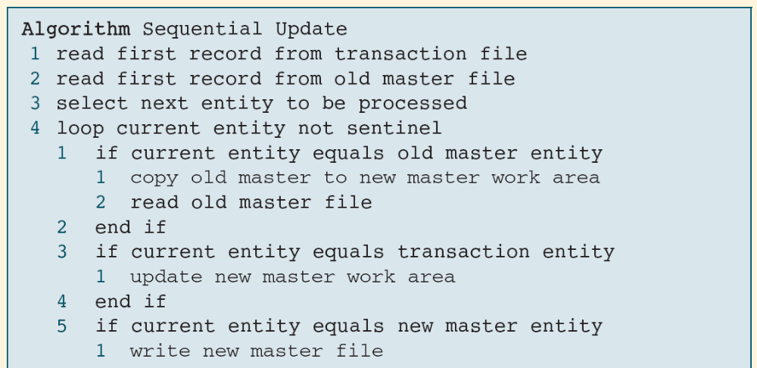
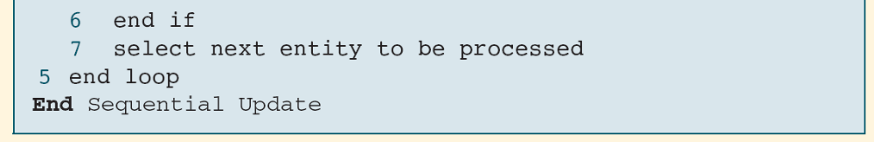
ALGORITHM 13-2
Pseudocode for File Update

